Slide 1
Better testing with Specflow
Using TicTacToe as the ‘domain’
Notes:
Question for audience:
How many of you like writing tests?
How many of you like maintaining tests? Especially someone elses tests?
(call audience out, accuse them of being liars. Most people hate writing tests. Even more people hate maintaining them and almost everybody hates maintaining someone elses tests. What if we could change that?

Slide 2
Introduction
The goal of this presentation is to persuade the audience that a ‘domain driven’ approach to testing is superior to a low level implementation driven unit test approach. In order to illustrate this, a public repository has been created which contains an implementation of TicTacToe along with some AI implementations. It also contains two testing projects, one uses the ‘domain driven’ approach and the other uses a more traditional suite of low level unit tests. During the last half of the presentation we will compare both testing strategies using the following criteria:
How fast are the tests?
How much overlap does the test have, that is, how much code does it invoke that has nothing to do with what is being tested?
How much code coverage does the approach provide?
How good are the tests at documenting the domain?
Does the testing strategy aid in driving good design? If so, how much?
How easy is it to identify the source of a breaking change when tests fail?
How resilient are the tests to refactoring of the implementation?
How easy is it for non-programmers to read and understand the tests?

Slide 3
But first…some definitions please
So how are these tests different than other tests you may have written in the past? We will define these ‘domain driven’ tests as tests that meet ALL of the following criteria:
The tests are fast. But to be as technical as possible, they are 'fast' because they should NOT cross ANY process boundaries: they do not call out to databases, no-sql stores, APIs or even the file system. Never. Ever. Ever.
The tests are independent of each other and can run in parallel in the same process.
The tests are designed and built along a well defined domain seam, sometimes referred to as a 'feature'. If there is no real domain seam (which could be the case if this is some cross cutting concern or supporting service), then the tests are built around the 'technical domain' seam (think logging service for example). If the project is large or ‘monolithic’ it may have several dozen domain seams.
Notes:
Despite my best efforts, I have failed to find a good way to describe the specific testing approach that is employed here.
By most definitions these tests would be considered closer to unit tests than integration tests.
But rather than try to overload these words with yet one more confusing definition, we will instead opt to very specifically delineate what these tests ARE and what they are NOT.

Slide 4
(Continued)
The tests provide first class documentation of the domain NOT the implementation.
The tests are 'high level' enough that they get to be as agnostic as possible to low level implementation details. That is to say, they are 'refactor friendly'
These 'domain tests' represent the bulk of our testing army. All other testing strategies represent a smaller share of the pie in our testing strategy (think of them as special forces there to supplement any gaps where this approach is less ideal). See the 'What is the shape of my test suite?' for examples of different testing populations you might have seen in other environments.
These 'domain tests' appropriately mock any dependencies that cross process boundaries and setup such mocks as to facilitate the specification testing that is done (note, sometimes this can be a bit difficult but the tradeoff is explained in depth later on).
Notes:
Despite my best efforts, I have failed to find a good way to describe the specific testing approach that is employed here.
By most definitions these tests would be considered closer to unit tests than integration tests.
But rather than try to overload these words with yet one more confusing definition, we will instead opt to very specifically delineate what these tests ARE and what they are NOT.

Slide 5
What is the shape my test suite?
Most teams employ tests from all brackets of available testing strategies (unit, integration, UAT, etc). In some cases, less mature shops may be missing certain layers like performance or load testing. The ratio of tests is what we will be talking about here. For example, the number of unit tests relative to the number of integration tests etc. Specifically, we are interested in figuring out what ratio provides the optimum amount of quality and/or maintainability for the least amount of money.
To help illustrate we will look at two possible models: The ‘pyramid model’ and what I like to call the ‘diamond model’.

Slide 6
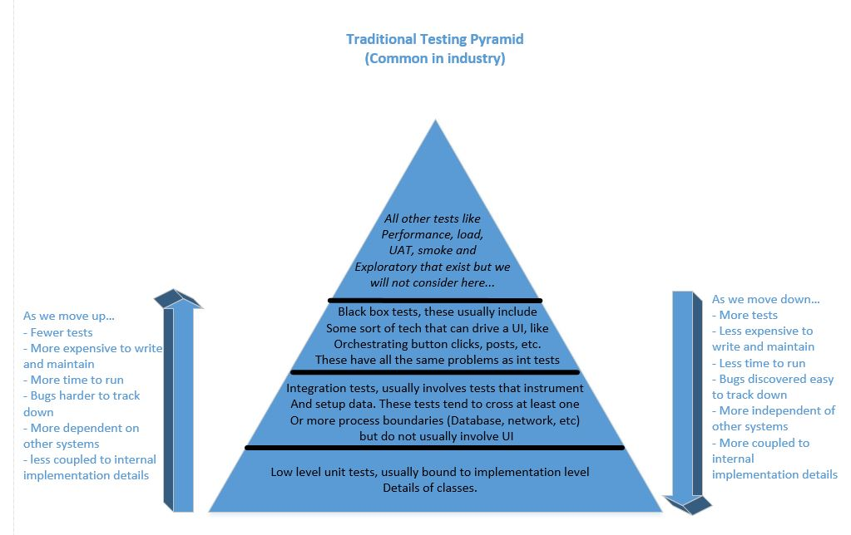
Notes:
Common, maybe because it is the easiest to get going

Slide 7
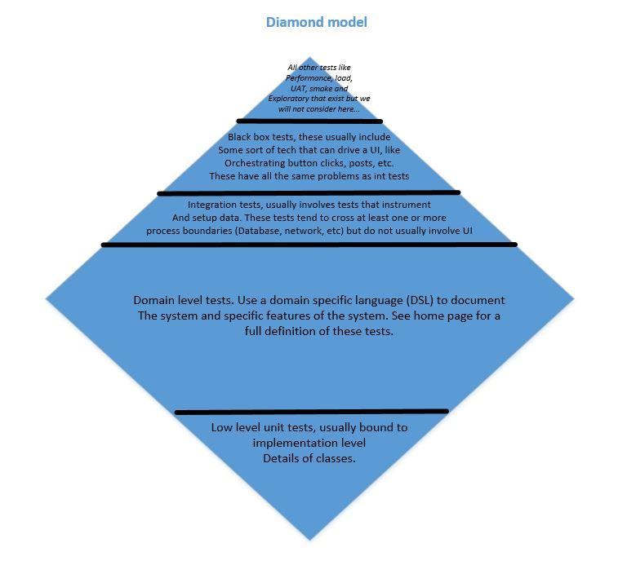

Slide 8
Nice story. Can we see some code?
Sure. Lets get started:
First you will want to clone the repository: https://github.com/softpsyche/TicTacToe
Make sure you have Visual studio 2017 installed.
Make sure you also install the Specflow extension for vs2017: https://marketplace.visualstudio.com/items?itemName=TechTalkSpecFlowTeam.SpecFlowforVisualStudio2017
The solution also makes use of the following Nuget packages:
Moq
Specflow
FluentAssertions
SimpleInjector

Slide 9
TicTacToe project overview
The solution contains five projects:
Arcesoft.TicTacToe.Common: has a small amount of supplemental code.
Arcesoft.TicTacToe: this is where the bulk of the code is and what are test suites are targeting. It contains the implementation for:
The tictactoe game object which encapsulates all the functionality needed to play a tic tac toe game along with all the rules
A ‘brute force’ AI that does just what its name implies to make moves
An ‘Omniscient God’ AI that makes is moves using an external dependency on a database (http://www.litedb.org/).
A database builder class which is capable of finding all possible moves and outcomes for any given tictactoe game.
Arcesoft.TicTacToe.ConsoleApplication: contains a very basic command line UI that lets you play games against:
Another human
Brute force AI
Omniscient God AI
Arcesoft.TicTacToe.CommonTestingApproach: A testing project with low level unit tests that target Arcesoft.TicTacToe
Arcesoft.TicTacToe.BetterTestingApproach: A testing project that has ‘Domain driven’ tests that target Arcesoft.TicTacToe. These are written using Specflow.
Notes:
Omniscient god AI is important because we have to contend with the external dependency.

Slide 10
Review the main classes…
Review the IGame interface
Review the IArtificialIntelligence interface
BruteForceAI
OmniscientGodAI
Review the IDatabaseBuilder interface
Notes:
Talk about the boundaries we have for Omniscient god AI

Slide 11
Lets look at a specflow test…
In the Game.Feature, we can review a very basic test to get a primer on specflow (‘new game should start in the correct state’)
Features – Contain one or more scenarios (represent a domain seam)
Scenario – Represents a single test, consists of 1 or more steps
Steps – A single given or when or then statement. These get bound to C# methods via attribute
Background – A list of common steps that get run before every scenario in the feature file
Show how to debug and set break points
Specflow uses convention and reflection to translate data input into .net classes (specflow tables, etc)
Specflow emits plain jane unit tests so all other tools like code coverage etc work seamlessly.
Review ‘Game should detect 'X' win for diagonal slope’
Notes:
Talk about ‘Game should detect 'X' win for diagonal grade’

Slide 12
Compare two testing approaches
Compare two individual tests
Specflow: Omniscient god AI should select winning X move
Unit: MakeMoveShouldMakeWinningMoveForX
Compare the suites of tests for code coverage
Notes:
Talk about the boundaries we have for Omniscient god AI

Slide 13
Maintenance, refactoring - costs
So to put this theory to the test, we identified a refactor that was needed to make this code base more maintainable, efficient etc. Lets review this now…
https://github.com/softpsyche/TicTacToe/wiki/Code-refactor
Notes:
Talk about the boundaries we have for Omniscient god AI

Slide 14
Bugs, bugs and more bugs
In a similar vein, lets put these tests on the spot by trying to introduce some bugs too how good they are at catching changes that break expected behavior.
(the branch below has a few examples…)
https://github.com/softpsyche/TicTacToe/compare/bug_attempts
Notes:
Talk about the boundaries we have for Omniscient god AI

Slide 15
Conclusions…
Sure, no changes were required when we refactored but is that just because the tests suck? Are they good enough to catch a bug had it been introduced? I think the answer is yes. In fact, I tried to introduce bugs myself (see this branch)and was actually astonished to find that the DSL tests were BETTER at catching most bugs i could think of than the low level unit tests. But you should try it yourself and be the judge..
Ok, maybe it could catch a bug but would it be as easy to track down the code that caused the bug? I think the answer here is technically no but practically yes. It would be slightly more difficult to track a bug down, but I believe we are talking about a difference in minutes vs seconds with the unit tests at worst. This trade off is well worth it in my opinion considering how much more time was spent actually fixing the low level tests.
Whatever, maybe the tests are good and maybe they are even good enough to allow bug fixing in a fast enough amount of time. But how fast are these tests compared to low level unit tests? I do not need yet another suite of 'wait until tomorrow to see if you broke something' tests. Ok, well the tests DO run a bit slower. However, the difference here should only be in the milliseconds range (say 2ms vs 1ms). This is still more than fast enough for a developer to run all tests before a check in. So again, I submit that the tradeoff is worth it.
Notes:
Talk about the boundaries we have for Omniscient god AI

Slide 16
Conclusions… (Continued)
Yeah, well, aren't these tests overlapping? I mean, A small change in one component can break multiple tests and isn't this kind of bad? Yes, there will be overlap because these tests will be more 'holistic'. Many components will be invoked in tests that may have nothing to do with said component. However, once we remember that the tests shouldn't care about our particular implementation, it makes sense that they would behave this way. And since they are bound to a true domain behavior, the trade off is particularly worthwhile because the domain is less likely to change than the implementation. And if the domain changes, the tests have to change anyways, regardless of what approach was used. As far as the performance hit goes for overlapping execution of code, see the above bullet as to why that is worth it.
Fine, I am convinced. All hail our new robot overlords, I will never write another unit test again! Right?? Right??? No, no and one more time no. The takeaway here is not that we have a magic bullet to solve any problems for any given scenario. In some cases, it may make more sense to write more low level unit tests. What I am saying is that you should challenge the way you look at testing and really think about testing in general. Think about it as hard as you think about your design and your implementation. Think about it during the whole SDLC, not just at the end. Think about from a domain perspective. Think about maintainability and change. This is not easy, it is hard. But I think the trade off can be well worth it. It may mean writing far fewer tests which are way better at actually documenting the things we REALLY care about the code - like its behavior (not what cute new Awesomo framework you plugged in to implement XYZ that will be obsolete tomorrow anyways). Tests that are fast, not cryptic and that allow you refactor your code with ease. Imagine that...
Notes:
Talk about the boundaries we have for Omniscient god AI

